Slide 1
ETL
Extract, Transform, Load
Natural Disasters
Orlando Leckie, William Abate, Verenice Vargas

Slide 2

What are natural disasters?
Natural disasters are extreme, sudden events caused by environmental factors.
Examples:
Earthquakes
Tsunamis
Hurricanes/Tropical Storms
Wildfires
Tornadoes
Sources:https://www.planetaryhealthalliance.org/natural-disasters ; https://www.samhsa.gov/find-help/disaster-distress-helpline/disaster-types ;
(Photo) https://www.kindpng.com/picc/m/44-442679_clip-art-wild-fires-trees-on-fire-clipart.png

Slide 3
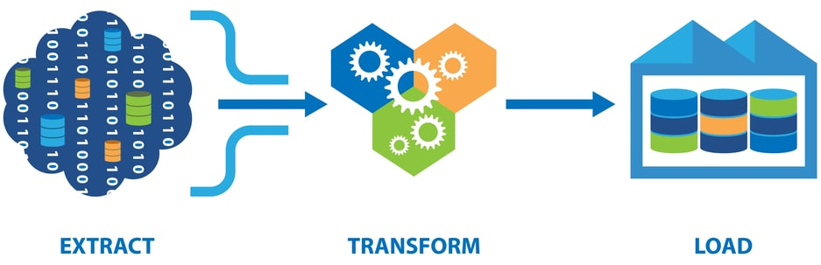
ETL
Sources: (Photo) https://qatesttraining.com/wp-content/uploads/2021/11/five-steps-of-etl-process.jpeg

Slide 4
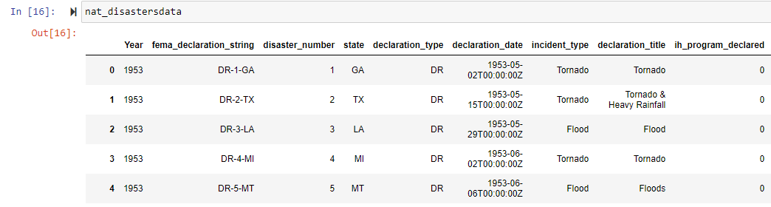
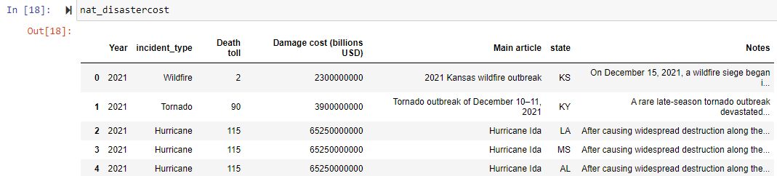
Extracting
*Extraction: your original data sources and how the data was formatted.
Sources:

Slide 5
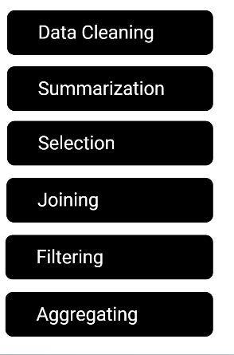
Transforming process
*Transform: what data cleaning and transformation was required
In order to transform the public data and use it in our study we performed the following:
Used Pandas functions in Jupyter Notebook to load two CSV files.
Reviewed the files and transformed into data frames
Dropped rows where the year was before 2000
Created queries to address our hypothesis by grouping the data by state and getting the sum of the number of people killed and the number of people injured. We sorted the data in descending order so we could visually see which state had the highest numbers.
Sources:

Slide 6
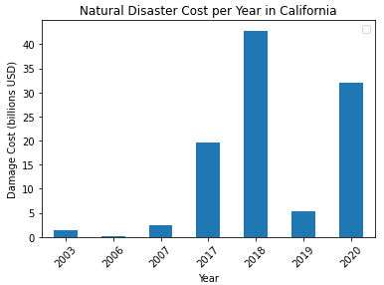
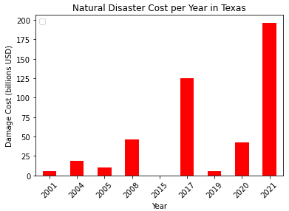
Natural Disaster Cost per Year
Sources:

Slide 7
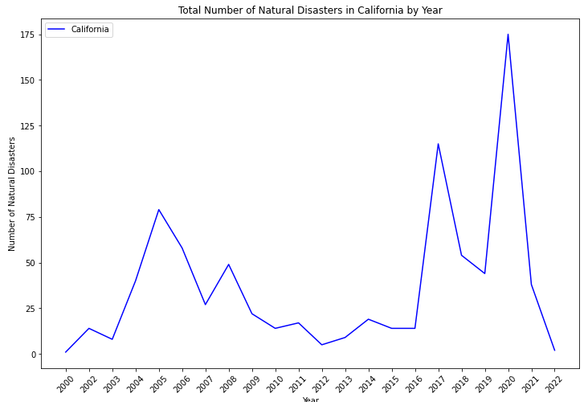
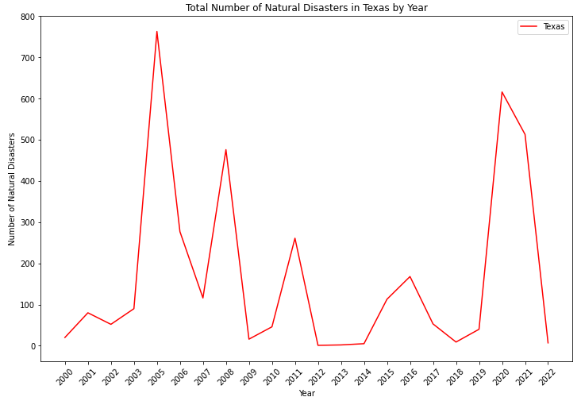
Total Number of Natural Disasters
Sources:

Slide 8
Loading process
*Loading: the final database, tables/collections, why this was chosen
Uploading commits to github through command prompt
Ex of loading process: The last step was to transfer our final output into a Database. We created a database and respective table to match the columns from the final Panda's Data Frame using Postgres database using PG admin to store our original clean data sets. We reconnected to the database and generated additional tables for the data frames.
Sources:

Slide 9
Summary

